Slide 1
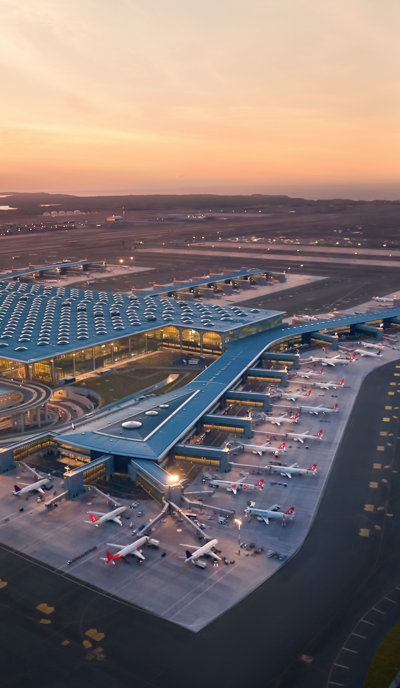

ADVERTISER PACK
2026 / 27
Reach the people
who buy.
For the people who run, build and equip airports worldwide.
AIRPORTBUSINESSMAGAZINE.COM
COGENT MULTIMEDIA LTD

Slide 2
WHO YOU REACH
The people you’re getting in front of.
THE LIST TODAY
14,743
named airport professionals subscribed to the newsletter.
Airport Business Magazine goes to airport chief executives, commercial directors and the heads of security, operations, passenger experience and cargo.
32,542
average monthly visits to the Airport Business Magazine website.
WHAT THEY BUY
Security screening and detection
62.1%
average open rate against an industry average of 25%.
Baggage handling and ground equipment
Terminal technology and passenger systems
Retail, food and drink concessions
Construction, design and engineering
Cargo, logistics and sustainability
7.17%
average click rate against an industry average of 2%.
AIRPORT BUSINESS MAGAZINE · WHO YOU REACH
2 / 7
Notes:
Subscribers: Mailchimp, subscribed members on 20 Oct 2026. Open and click rates: pooled across all 12 issues sent to this list. Visits: GA4 sessions, 2026-09-20 to 2026-10-19.

Slide 3
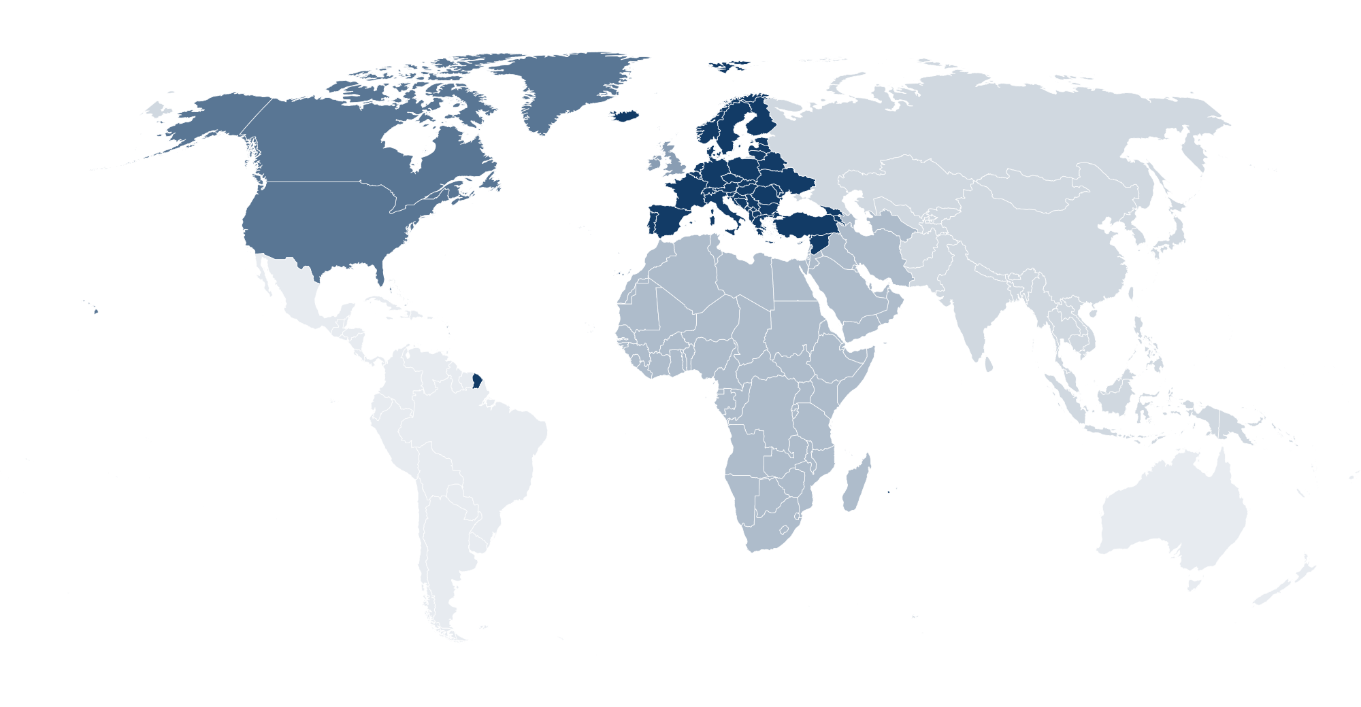
WHO READS · PROJECTED AT SCALE
Who reads Airport Business Magazine
86% sit at manager level or above. Projected profile at scale, for planning. Measured figures replace these as the list is profiled.
8.0%
34%
44%
14%
WHERE THEY ARE
CEO or managing director
Director
Manager
Specialists
MOST COMMON ROLES
Operations managers
18%
Commercial and retail directors
12%
Security managers
10%
Engineering and estates
9.0%
Airport CEOs and MDs
8.0%
Passenger experience
8.0%
28%
22%
18%
16%
16%
Europe
North America
UK and Ireland
Middle East and Africa
Asia
ORGANISATION
DEPARTMENT
AIRPORT SIZE, PASSENGERS A YEAR
Airport operators
48%
Operations
34%
Under 1m
22%
Suppliers and contractors
26%
Commercial
20%
1m to 5m
30%
Airlines and handlers
16%
Engineering
16%
5m to 20m
28%
Consultants and government
10%
Security
14%
Over 20m
20%
Finance and HR
10%
AIRPORT BUSINESS MAGAZINE · WHO READS
3 / 7

Slide 4
WHAT YOU CAN BUY
Four ways in.
Every format is digital. Our subscribers have requested to receive content from brands who are able to help their business.
Website banners
Sponsored newsletter content
970×250
300×250
Your brand across the whole site.
Sponsored
Your story in our Monday Briefing, next to our editorial and labelled as sponsored.
HOW A BOOKING RUNS
728×90
01
You tell us what channels you want to use.
970×250 · 728×90 · 300×250
400 words · logo · one link
02
We confirm format, date and price in writing.
03
You send artwork, or copy and we build it.
Newsletter sponsorship
Solus email
04
You approve it before anything goes out.
Sponsor
05
We send the report on your campaign alone.
Your brand as the named sponsor of every issue of our Monday Briefing.
Your email
Your own email, sent to our subscribers. Nobody else in it.
Banner
Per issue, or sponsor a series
We build it, or send finished HTML
AIRPORT BUSINESS MAGAZINE · WHAT YOU CAN BUY
4 / 7

Slide 5
RATES
Build a campaign.
FORMAT
ONE
THREE
SIX
EMAIL
Our team of marketing experts can work with you to build bespoke campaigns to fit your advertising goals and strategies.
All marketing options are built to send our audience straight to your website with one easy click.
Whatever you chose, it’s designed to deliver traffic to you.
Eshot
£1,000
£750
£500
Your message alone, nobody else in it
EACH
EACH
Newsletter sponsorship
£800
£600
£400
Named sponsor of the Monday Briefing
EACH
EACH
CONTENT
Sponsored article
£200
£150
£100
On the website and in the newsletter
EACH
EACH
DISPLAY
ONE MONTH
THREE MONTH
SIX MONTH
Homescreen Pop-Up
£1,200
£2,700
£3,600
Pops up after 6 seconds
TOTAL
TOTAL
Billboard, 970×250
£900
£2,100
£3,000
TALK IT THROUGH
Top of the homepage
TOTAL
TOTAL
jb@airportbusinessmagazine.com
Leaderboard, 728×90
£600
£1,200
£1,800
Across the site
TOTAL
TOTAL
MPU, 300×250
£400
£800
£1,200
Sidebar button
TOTAL
TOTAL
All rates exclude VAT
AIRPORT BUSINESS MAGAZINE · RATES
5 / 7

Slide 6
WHAT RESULTS YOU GET
The numbers
you get back.
Statistics
All numbers are an average
EMAIL CAMPAIGN
Delivered
Inboxes it actually reached
14,743
Within 7 days of your campaign finishing, you’ll receive a full performance report showing impressions, open rate and click-throughs to your website.
Unique opens
People who opened, counted once
62.1%
Unique clicks
People who clicked, counted once
7.2%
Click to open
Of those who opened, who then clicked
11.6%
Unsubscribes
Off the list after your send
0.06%
ON THE SITE
Monthly Total Visits
Total impressions on your content
32,542
WHEN YOU GET A REPORT
Monthly Unique Visitors
Unique users who saw your content
17,508
Within 7 working days of the send.
AIRPORT BUSINESS MAGAZINE · WHAT RESULTS YOU GET
6 / 7
Notes:
Delivered is the current list size. Rates pooled across 12 issues. Visits and unique visitors: GA4 sessions and total users, 2026-09-20 to 2026-10-19.

Slide 7
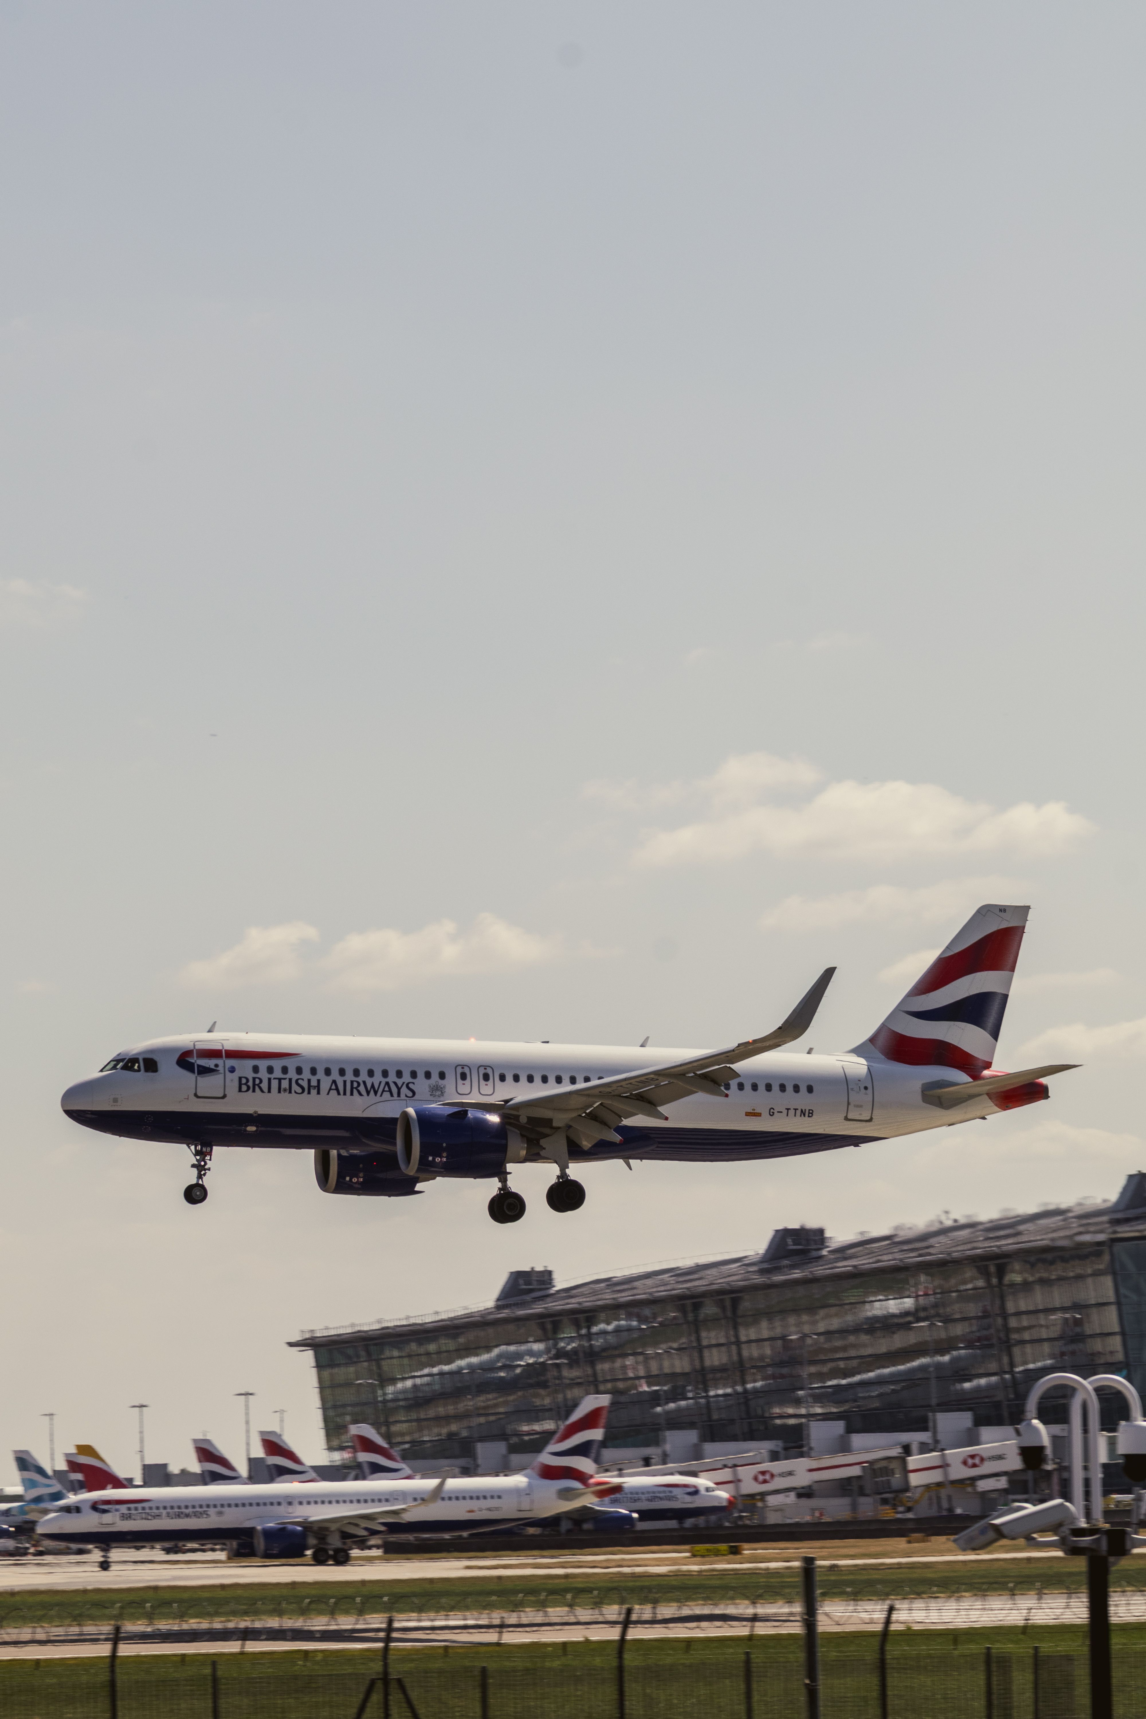
ADVERTISE WITH US
Get in touch.
Tell us who you are trying to reach and what you want it to do, and we will come back with a plan, availability and a price.
ADVERTISING
jb@airportbusinessmagazine.com
SEND US A STORY
airportbusinessmagazine.com/submit-news
SUBSCRIBE FREE
airportbusinessmagazine.com/newsletter
PUBLISHED BY · COGENT MULTIMEDIA LTD, 5 JUBILEE WAY, FAVERSHAM, KENT

